Slide 1
THREE Rivers Levee Improvement Authority (TRLIA) Yuba Goldfields 100-Year Interim Flood Protection Project, Yuba County August 28, 2015
APPLICATION NO. 19046
Notes:
Pointer - visible
Steve Cheney or Mike Bruchner UPRR (Nebraska)
Branden Straham, UPRR Consultant (hydraulics)
John Schoonover, CH2M Hill UPRR consultant
Sean Minard LD1

Slide 2
BOARD ACTION
Consider approval of Permit No. 19046 to:
to enlarge and reshape existing dredge tailing embankments,
construct a 16-foot-wide patrol road on the embankment crest,
construct access ramps within the Yuba Goldfields, and
*allow construction activities during the flood season.

Slide 3
AUTHORITY OF THE BOARD
California Water Code § 8534, 8590 – 8610.5, and 8700 – 8710
Title 23 standards:
§ 6 – Need for a Permit
§ 11 – Variances
§ 13 – Evidentiary Hearings
§ 112 – Streams Regulated and Nonpermissible Work Periods
§ 116 – Borrow and Excavation
§ 121 – Erosion Control
§ 130 – Patrol Roads and Access Ramps

Slide 4
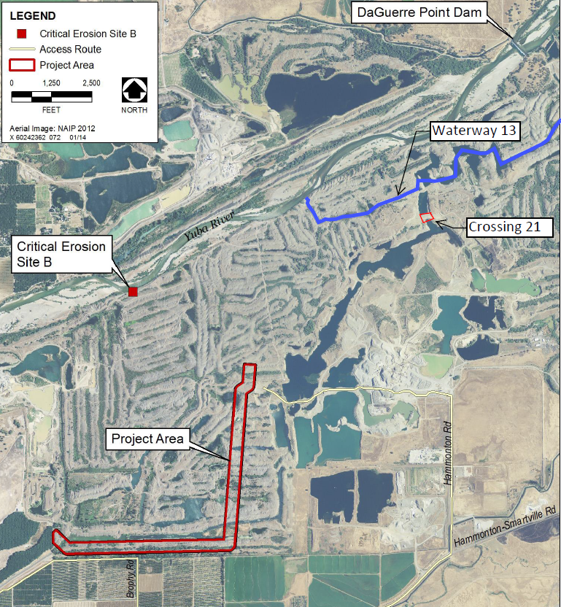
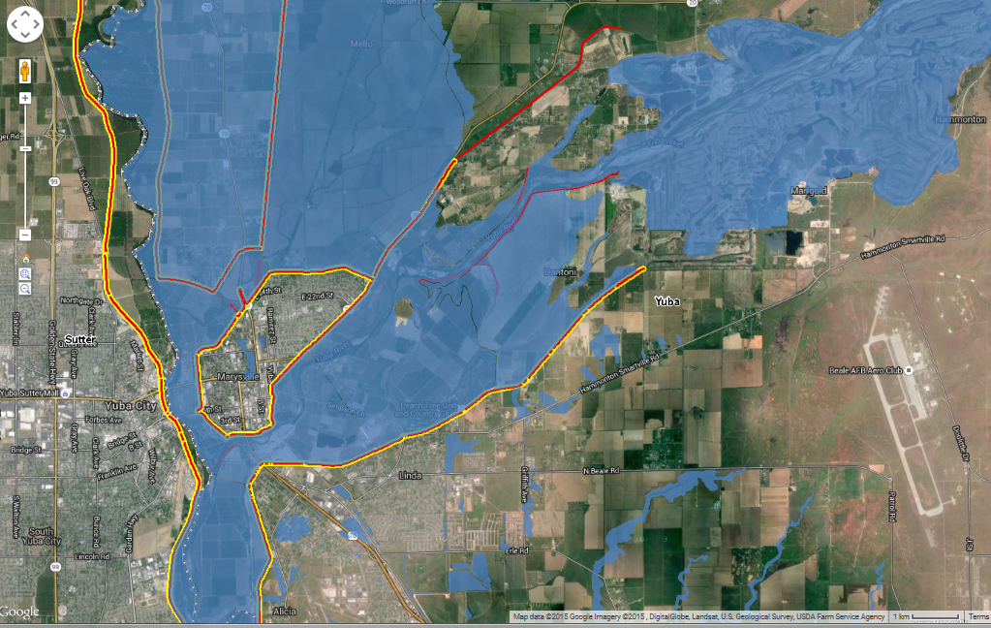
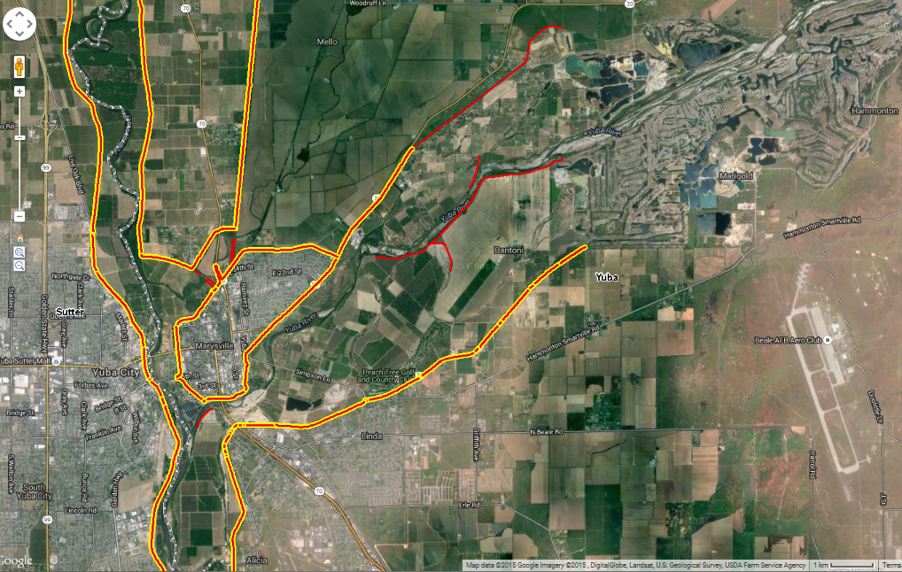
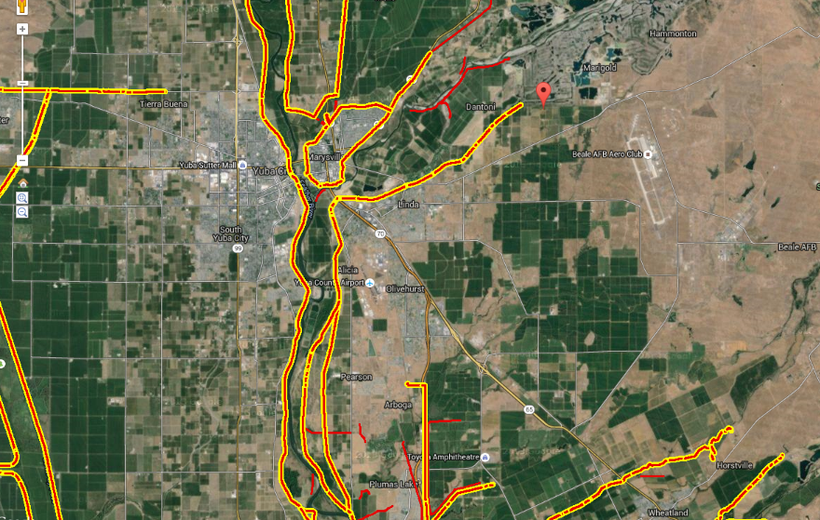
PROJECT LOCATION
Daguerre Point Dam
Daguerre Point Dam
Yuba River
Proposed Tailing Embankments
Marysville
Yuba City
Yuba River
Linda
The project is located:
In Yuba County
Approximately 10 miles northeast of Marysville
Upstream of RD 784 urban areas of Linda and Olivehurst
Proposed Tailing Embankment “Crossing 21”
Olivehurst
Proposed 2.1 mile Tailing Embankment Extension
Notes:
* Improvements away from the levee

Slide 5
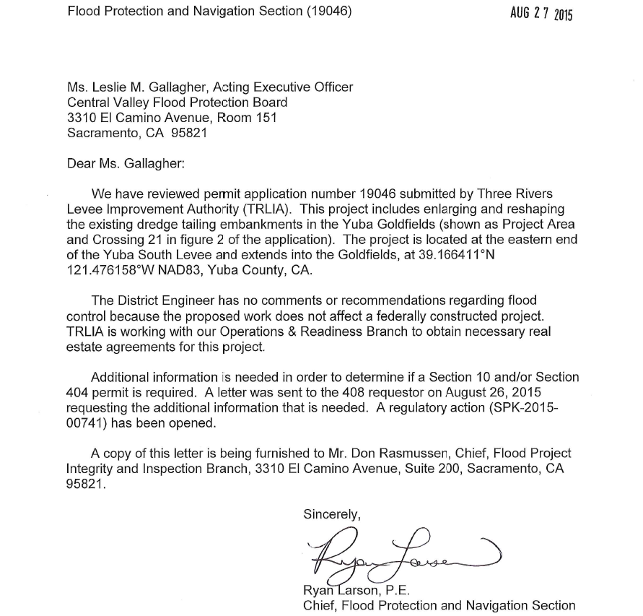
COMMENTS & ENDORSEMENTS
U.S. Army Corps of Engineers non-federal letter received August 27, 2015
USACE District Engineer has no comments or recommendations because the project does not affect a federally constructed project
TRLIA endorsed the project on May 28, 2015 – the Goldfields are not currently part of an existing LMA, therefore TRLIA will be responsible for maintenance of this interim project

Slide 6
PROJECT BACKGROUND (1/2)
TRLIA constructed a group of projects to provide 200-year flood protection to the RD 784 urban area (10 years and nearly $400 million)
A permanent 200-year flood protection project is currently in design
Goldfields were formed by hydraulic mining (since the early 1900s)
The RD 784 levee system is part of the SPFC within the Sacramento River Flood Control Project (SRFCP) and in a 1953 memorandum between the Federal government and the State of California, the Goldfields are called “high ground”
Research for the “high ground” determination indicates the decision was made based on an original Yuba River design flow of 120,000 cfs
Design flow was increased to 180,000 cfs in 1970 with the authorization of the New Bullards Bar Dam on the North Fork of the Yuba River
TRLIA has been unable to locate documentation from the USACE or State to confirm that the Goldfields would function as high ground at 180,000 cfs
Notes:
O M 3 R

Slide 7
PROJECT BACKGROUND (2/2)
Evaluations from 2010 to 2013 identified significant erosion points in the south bank tailing mounds of the Yuba River that may breach and allow Yuba River flood flows to enter the Goldfields during a 100-year event
if the Goldfields can’t contain the flows then flooding in RD 784’s urban area could occur
The proposed interim project is in advance of the future 200-year flood protection project for the Goldfields and would improve the functionality of the SPFC, without modifying SPFC facilities or affecting the SRFCP
It will prevent flanking of the SPFC facilities during a 100-year event
Notes:
O M 3 R

Slide 8
FLOOD SEASON CONSTRUCTION
Due to current public safety risk to RD 784 urban area → TRLIA is requesting Board approval to continue the interim 100-year construction through the flood season**
The following Board standard applies to TRLIA’s requests:
§ 112(b)(2) – “The board, at the prior written request of the applicant, may allow work to be done during the flood season within the floodway, provided that, in the judgment of the board, forecasts for weather and river conditions are favorable.”
Per Title 23, Table 8.1, the flood season for the Yuba River is November 1 to April 15
Request allows construction during the flood season, as needed for completion
TRLIA determined it is possible to construct during the flood season in wet weather:
material properties of dredge tailings, which drain freely → within a few days of heavy rain it can be excavated, placed, and compacted without pumping issues*
proposed embankments separated from the Yuba River by thousands of feet
shaping of these embankments with dredge tailing fill will not adversely impact river hydraulics during or after construction because of existing activities and conditions
Board staff determined that the variance to Board’s standards can be approved without adverse risk to the SRFCP or SPFC facilities and can be constructed in this area regardless of weather conditions (Special Condition TWENTY-FOUR added to permit)
Notes:
Done at the time of permit hearing and not after, it will be incorporated into this permit and standard 11© does not apply (Board action not Chief Engineer or EO)

Slide 9
REAL ESTATE CONSIDERATIONS
Project is located on property owned in fee by Western Aggregates (for the 2.1 miles of embankment extension) and the USACE (for the “Crossing 21” embankment location)
The lands are regulated by the State Mining and Geology Board
Western Aggregates holds vested surface aggregate mining rights along the embankment extension
Cal-Sierra Development holds vested mineral rights along a portion of the embankment extension and for “Crossing 21”
Rather than obtaining fee title or an easement for an interim project TRLIA will execute co-operation agreements with Western Aggregates (executed), Cal-Sierra Development (executed), and the USACE (drafted)
agreements will allow TRLIA to construct and maintain the 100-year embankments for the next 10 years with options to extend the agreements if needed
TRLIA would be responsible for all regular O&M activities
Board staff has incorporated Special Condition SEVENTEEN to require execution and review by the Board of said Co-operation Agreements prior to the start of construction at the specific project locations
Notes:
O M 3 R

Slide 10
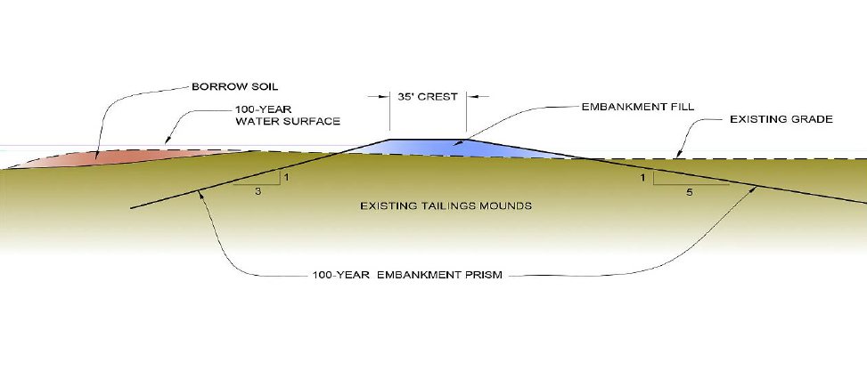
PROJECT DETAILS
Proposed embankments constructed using existing dredge tailings
minimum crown (top) width of 35 feet
waterside 3:1 (horizontal to vertical) and landside 5:1 slopes
crown constructed to a height 3 feet above the 100-year WSE
Approximately 200,000 cubic yards (CY) of tailings will be placed to extend approximately 2.1 miles of high ground into the Goldfields from the YRSL
Approximately 10,000 CY of tailings will be placed at “Crossing 21”
Fill material will be required to be primarily granular, limited to a maximum particle size of 10 inches, will be spread in maximum 18-inch lifts, and compacted by the weight of equipment and at least one pass of either a vibratory or other compaction roller
A 16-foot wide patrol road will be constructed on the crest
Notes:
Constructed in 1939
Temporary ramps = 400 cy fill

Slide 11
HYDRAULIC SUMMARY
Hydraulic Summary:
designed to intercept and block 100-year breach flows originating from YRSL and hold them long enough to allow flood peaks to pass
blocked flows would then return to the Yuba River or percolate into underlying groundwater aquifers
Both embankment locations are removed and separated from the Yuba River by thousands of feet of existing dredge tailings
shaping of these embankments with dredge tailing material would result in no changes to the existing Yuba River floodway and thus no impacts to river hydraulics would result (convey flood flows in the same manner as today)
Board staff has determined that the project is not anticipated to result in any adverse hydraulic impacts to the SRFCP, nor will it modify or affect existing SPFC facilities.

Slide 12
GEOTECHNICAL SUMMARY
The dredge material offers its own protection to rain erosion once the surface fines have been washed away and gullying is not an issue with this material
Board staff agrees with TRLIA’s assessments, which indicate that the proposed project and fill placement (within an active mining area outside of the SPFC) will cause no adverse geotechnical impacts to the SRFCP or existing SPFC facilities.

Slide 13
CEQA / WATER CODE 8610.5
CEQA Analysis is included in Staff Report Section 8.0
Water Code §§ 8610.5 Considerations are included in Staff Report Section 9.0

Slide 14
STAFF RECOMMENDATION
Board Staff Recommends that the Board:
Adopt:
the CEQA findings;
Approve:
*construction during the flood season from November 1 through April 15;
draft Encroachment Permit No. 19046 (in substantially the form provided); and
Direct:
the Executive Officer to take the necessary actions to file a Notice of Determination with the State Clearinghouse and execute the permit.

Slide 15
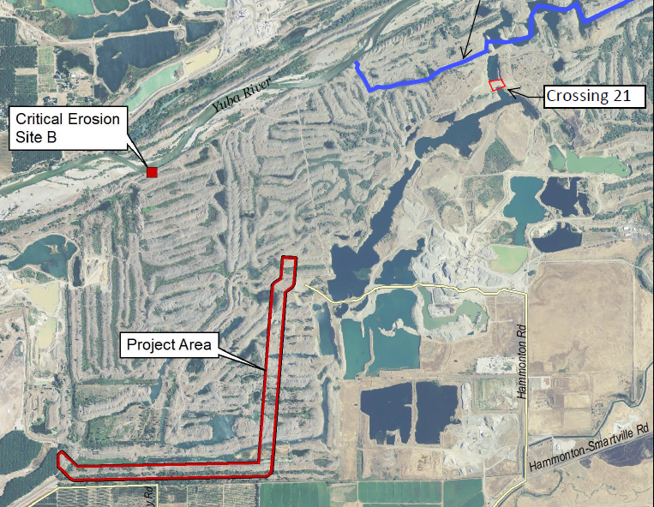
QUESTIONS
Presented by: Nancy Moricz, Senior Engineer

